Slide 1
Regression Analysis
Logistic Regression
Nicoleta Serban, Ph.D.
Professor
Stewart School of Industrial and Systems Engineering
Statistical Inference

Slide 2

About This Lesson

Slide 3
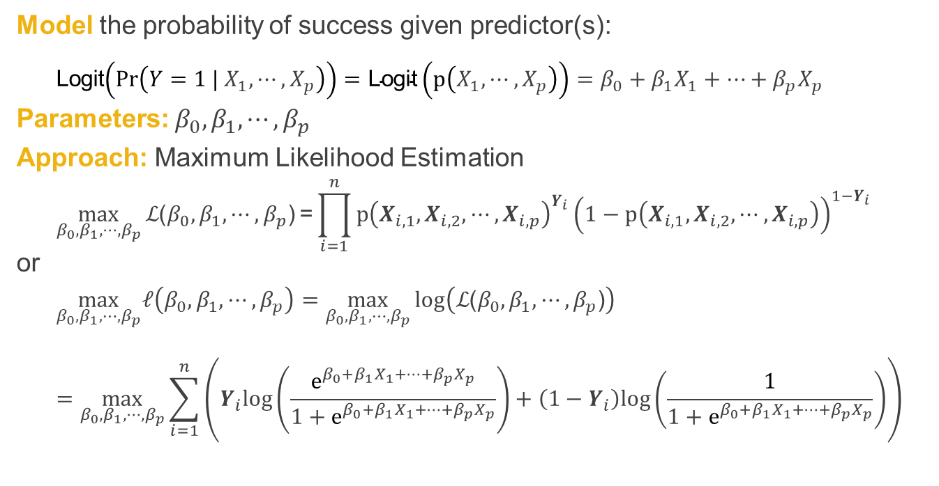
Model Estimation
Model the probability of success given predictor(s):
Logit$\left(Pr\left(Y=1 |{ X}_{1},⋯,X_{p}\right)\right)=\text{Logit}\left(p\left(X_{1},⋯,X_{p}\right)\right)=β_{0}+β_{1}X_{1}+⋯+β_{p}X_{p}$
Parameters: $β_{0},β_{1},⋯,β_{p}$
Approach: Maximum Likelihood Estimation
$$\max_{β_{0},β_{1},⋯,β_{p}}{ℒ\text{(}β_{0},β_{1},⋯,β_{p}\text{)}}\text{=}\prod_{i=1}^{n}{p{\left(X_{i,1},X_{i,2},⋯,X_{i,p}\right)}^{Y_{i}}}{\left(1−p\left(X_{i,1},X_{i,2},⋯,X_{i,p}\right)\right)}^{1−Y_{i}}$$
or
$$\max_{β_{0},β_{1},⋯,β_{p}}ℓ\left(β_{0},β_{1},⋯,β_{p}\right)=\max_{β_{0},β_{1},⋯,β_{p}}{log\left(ℒ\text{(}β_{0},β_{1},⋯,β_{p}\text{)}\right)}$$
$$=\max_{β_{0},β_{1},⋯,β_{p}}{\sum_{i=1}^{n}{\left(Y_{i}log\left(\frac{e^{β_{0}+β_{1}X_{1}+⋯+β_{p}X_{p}}}{1+e^{β_{0}+β_{1}X_{1}+⋯+β_{p}X_{p}}}\right)+\left(1−Y_{i}\right)log\left(\frac{1}{1+e^{β_{0}+β_{1}X_{1}+⋯+β_{p}X_{p}}}\right)\right)}}$$

Slide 4
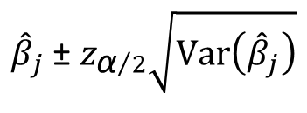
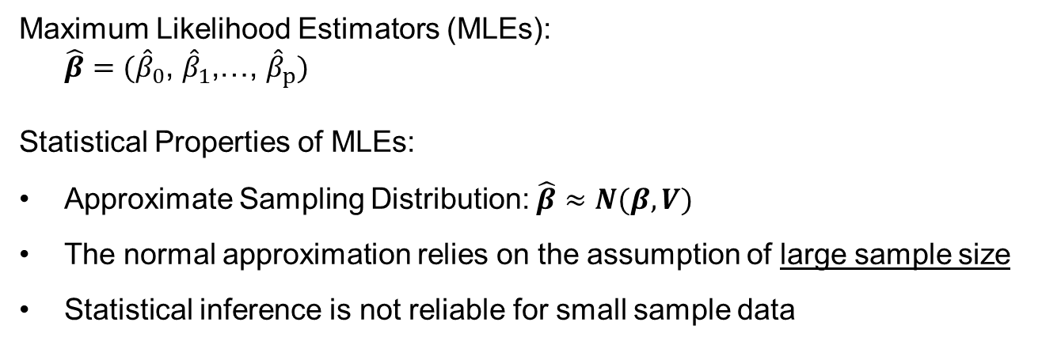
Statistical Inference
Maximum Likelihood Estimators (MLEs):
$$\hat{β}={(\hat{β}}_{0}\text{, }{\hat{β}}_{1}\text{,…, }{\hat{β}}_{p})$$
Statistical Properties of MLEs:
Approximate Sampling Distribution: $\hat{β}≈N(β,V)$
The normal approximation relies on the assumption of large sample size
Statistical inference is not reliable for small sample data
1-α Approximate
Confidence interval
$${\hat{β}}_{j} \text{±} z_{{\text{α}}/2}\sqrt{\text{Var}\left({\hat{β}}_{j}\right)}$$

Slide 5
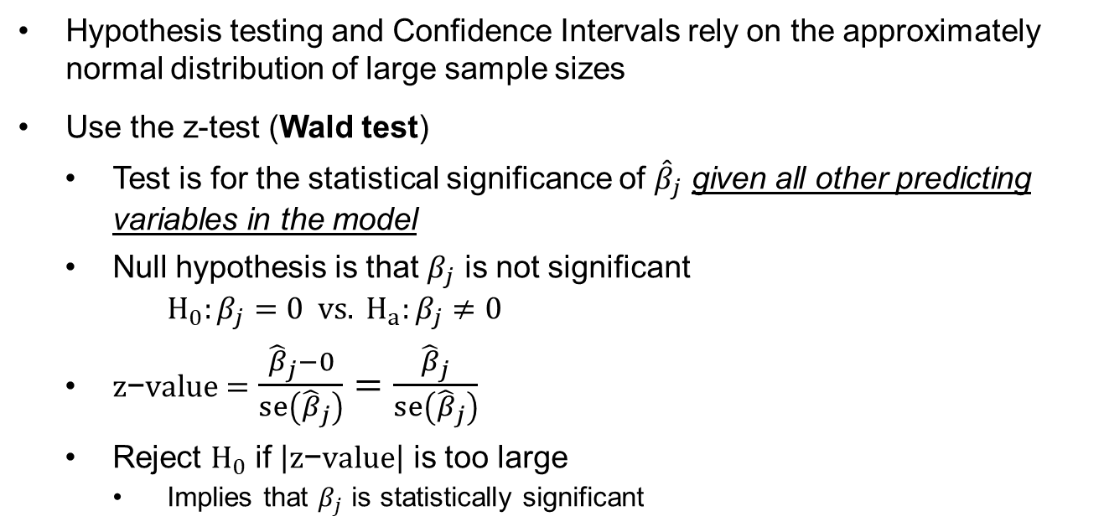
Statistical Inference (cont’d)
Hypothesis testing and Confidence Intervals rely on the approximately normal distribution of large sample sizes
Use the z-test (Wald test)
  Test is for the statistical significance of ${\hat{β}}_{j}$ given all other predicting variables in the model
  Null hypothesis is that $β_{j}$ is not significant
$$H_{0}:β_{j}=0 vs. H_{a}:β_{j}≠0$$
  $z\text{−}value=$ $\frac{{\hat{β}}_{j}−0}{se\left({\hat{β}}_{j}\right)}=\frac{{\hat{β}}_{j}}{se\left({\hat{β}}_{j}\right)}$
  Reject $H_{0}$ if $\left|z\text{−}value\right|$ is too large
    Implies that $β_{j}$ is statistically significant

Slide 6
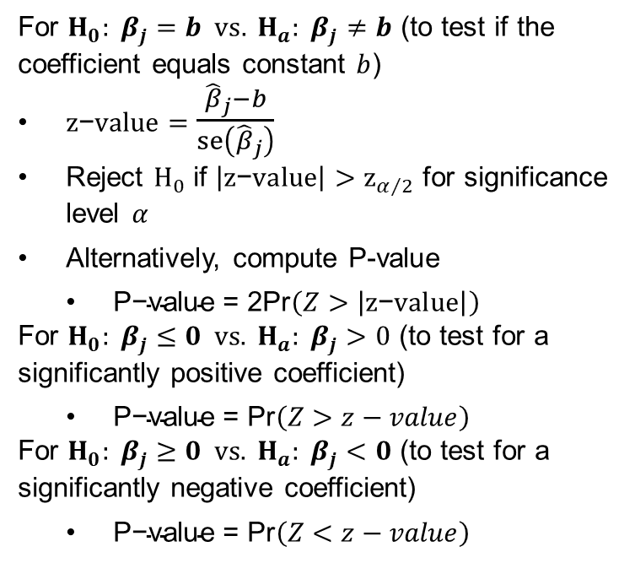
Statistical Inference (cont’d)
For $H_{0}: β_{j}=b vs. H_{a}: β_{j}≠b$ (to test if the coefficient equals constant $b$)
$z\text{−}value=$ $\frac{{\hat{β}}_{j}−b}{se\left({\hat{β}}_{j}\right)}$
Reject $H_{0}$ if $\left|z\text{−}value\right|>z_{α/2}$ for significance level $α$
Alternatively, compute P-value
  $\text{P}\text{−}\text{value}\text{ = 2}\text{Pr}\left(Z>\left|z\text{−}value\right|\right)$
For $H_{0}: β_{j}≤0 vs. H_{a}: β_{j}>0$ (to test for a significantly positive coefficient)
  $\text{P}\text{−}\text{value} \text{=} \text{Pr}\left(Z>z−value\right)$
For $H_{0}: β_{j}≥0 vs. H_{a}: β_{j}<0$ (to test for a significantly negative coefficient)
  $\text{P}\text{−}\text{value} \text{=} \text{Pr}\left(Z<z−value\right)$

Slide 7
Statistical Inference (cont’d)
For $H_{0}: β_{j}=b vs. H_{a}: β_{j}≠b$ (to test if the coefficient equals constant $b$)
$z\text{−}value=$ $\frac{{\hat{β}}_{j}−b}{se\left({\hat{β}}_{j}\right)}$
Reject $H_{0}$ if $\left|z\text{−}value\right|>z_{α/2}$ for significance level $α$
Alternatively, compute P-value
  $\text{P}\text{−}\text{value}\text{ = 2}\text{Pr}\left(Z>\left|z\text{−}value\right|\right)$
For $H_{0}: β_{j}≤0 vs. H_{a}: β_{j}>0$ (to test for a significantly positive coefficient)
  $\text{P}\text{−}\text{value} \text{=} \text{Pr}\left(Z>z−value\right)$
For $H_{0}: β_{j}≥0 vs. H_{a}: β_{j}<0$ (to test for a significantly negative coefficient)
  $\text{P}\text{−}\text{value} \text{=} \text{Pr}\left(Z<z−value\right)$
Because the approximation of the normal distribution relies on large sample size, so do the hypothesis testing procedures.
What if n is small?
The hypothesis testing procedure will have a probability of type I error larger than the significance level.
In other words, there will likely be more type I errors than expected.

Slide 8
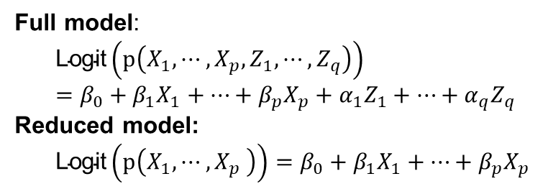
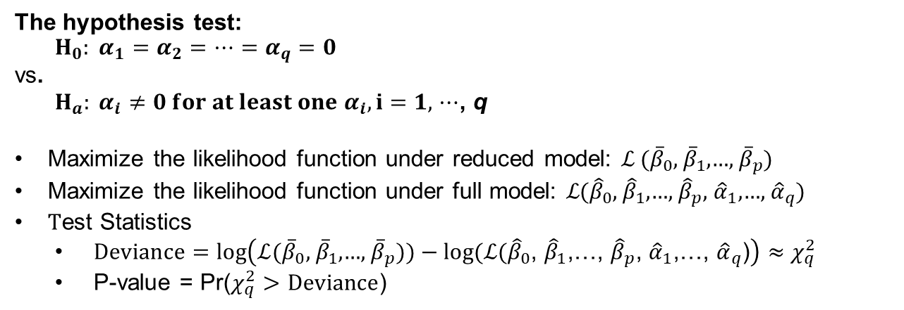
Testing for Subsets of Coefficients
Full model:
$$\text{Logit}\left(p\left(X_{1},⋯,X_{p},Z_{1},⋯,Z_{q}\right)\right)=β_{0}+β_{1}X_{1}+⋯+β_{p}X_{p}+α_{1}Z_{1}+⋯+α_{q}Z_{q}$$
Reduced model:
$$\text{Logit}\left(p\left(X_{1},⋯,X_{p} \right)\right)=β_{0}+β_{1}X_{1}+⋯+β_{p}X_{p}$$
The hypothesis test:
$$H_{0}: α_{1}=α_{2}=⋯=α_{q}=0$$
vs.
$H_{a}: α_{i}≠0 for at least one{ α}_{i}, i=1,$ $⋯$, q
Maximize the likelihood function under reduced model: ℒ ${(\overline{β}}_{0}\text{, }{\overline{β}}_{1}\text{,…, }{\overline{β}}_{p})$
Maximize the likelihood function under full model: ℒ${(\hat{β}}_{0}\text{, }{\hat{β}}_{1}\text{,…, }{\hat{β}}_{p}$, ${\hat{α}}_{1}\text{,…, }{\hat{α}}_{q}$)
Test Statistics
  $Deviance=log\left(\text{ℒ}{(\overline{β}}_{0}\text{, }{\overline{β}}_{1}\text{,…, }{\overline{β}}_{p}))−log(\text{ℒ}{(\hat{β}}_{0}\text{, }{\hat{β}}_{1}\text{,…, }{\hat{β}}_{p}\text{, }{\hat{α}}_{1}\text{,…, }{\hat{α}}_{q}\text{)}\right)≈χ_{q}^{2}$
  P-value = Pr($χ_{q}^{2}>$ $Deviance$)

Slide 9
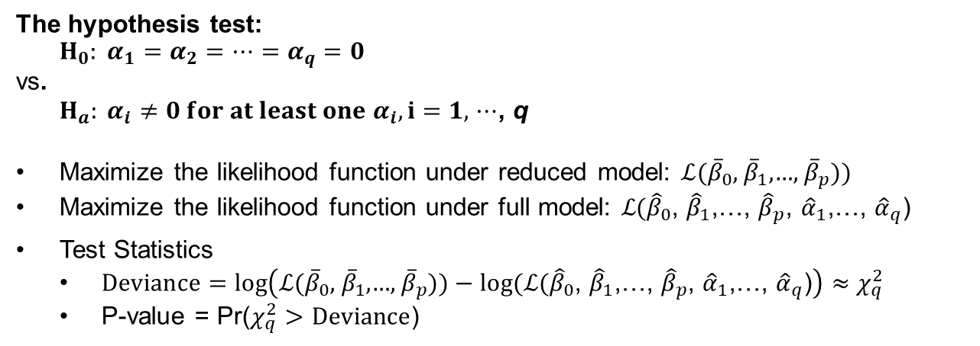
Testing for Subsets of Coefficients
Full model:
$$\text{Logit}\left(p\left(X_{1},⋯,X_{p},Z_{1},⋯,Z_{q}\right)\right)=β_{0}+β_{1}X_{1}+⋯+β_{p}X_{p}+α_{1}Z_{1}+⋯+α_{q}Z_{q}$$
Reduced model:
$$\text{Logit}\left(p\left(X_{1},⋯,X_{p} \right)\right)=β_{0}+β_{1}X_{1}+⋯+β_{p}X_{p}$$
The hypothesis test for subsets of coefficients is approximate
  It relies on large sample size
This is not a test for goodness of fit!
  It only compares two models
The hypothesis test:
$$H_{0}: α_{1}=α_{2}=⋯=α_{q}=0$$
vs.
$H_{a}: α_{i}≠0 for at least one{ α}_{i}, i=1,$ $⋯$, q
Maximize the likelihood function under reduced model: $\text{ℒ}{(\overline{β}}_{0}\text{, }{\overline{β}}_{1}\text{,…, }{\overline{β}}_{p}))$
Maximize the likelihood function under full model: ℒ${(\hat{β}}_{0}\text{, }{\hat{β}}_{1}\text{,…, }{\hat{β}}_{p}$, ${\hat{α}}_{1}\text{,…, }{\hat{α}}_{q}$)
Test Statistics
  $Deviance=log\left(\text{ℒ}{(\overline{β}}_{0}\text{, }{\overline{β}}_{1}\text{,…, }{\overline{β}}_{p}))−log(\text{ℒ}{(\hat{β}}_{0}\text{, }{\hat{β}}_{1}\text{,…, }{\hat{β}}_{p}\text{, }{\hat{α}}_{1}\text{,…, }{\hat{α}}_{q}\text{)}\right)≈χ_{q}^{2}$
  P-value = Pr($χ_{q}^{2}>$ $Deviance$)

Slide 10
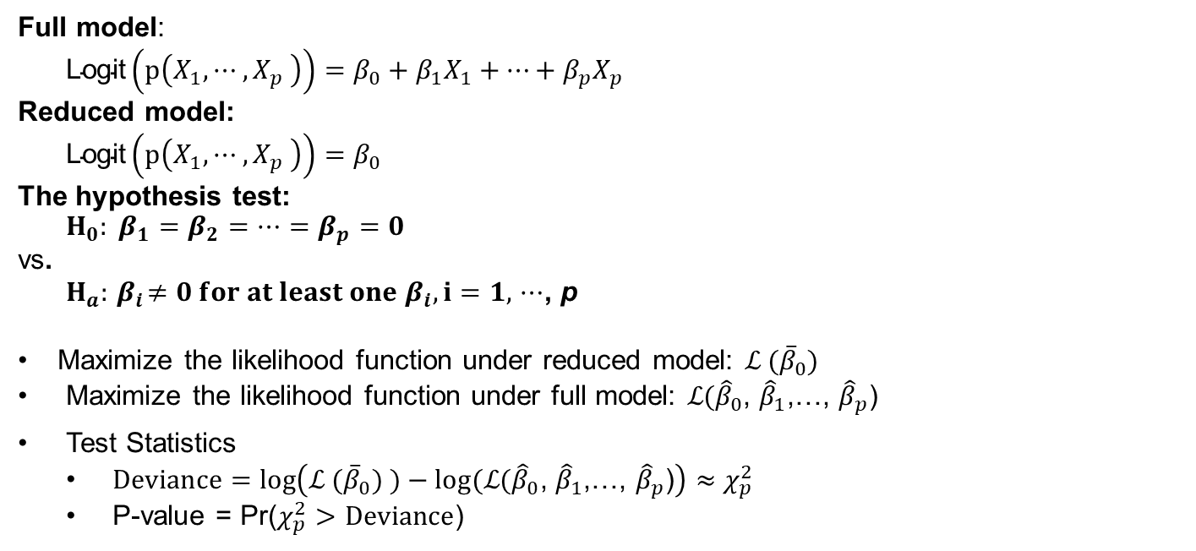
Testing for Overall Regression
Full model:
$$\text{Logit}\left(p\left(X_{1},⋯,X_{p} \right)\right)=β_{0}+β_{1}X_{1}+⋯+β_{p}X_{p}$$
Reduced model:
$$\text{Logit}\left(p\left(X_{1},⋯,X_{p} \right)\right)=β_{0}$$
The hypothesis test:
$$H_{0}: β_{1}=β_{2}=⋯=β_{p}=0$$
vs.
$H_{a}:{ β}_{i}≠0 for at least one{ β}_{i}, i=1,$ $⋯$, p
Maximize the likelihood function under reduced model: ℒ ${(\overline{β}}_{0})$
Maximize the likelihood function under full model: ℒ${(\hat{β}}_{0}\text{, }{\hat{β}}_{1}\text{,…, }{\hat{β}}_{p}$)
Test Statistics
  $Deviance=log\left(\text{ℒ} {(\overline{β}}_{0}) )−log(\text{ℒ}{(\hat{β}}_{0}\text{, }{\hat{β}}_{1}\text{,…, }{\hat{β}}_{p}\text{)}\right)≈χ_{p}^{2}$
  P-value = Pr($χ_{p}^{2}>$ $Deviance$)

Slide 11

Summary

